Slide 1

Neurodevelopmental differences in affective representations between adults and children:
A presentation for the Philadelphia Decision Neuroscience Symposium
William J. Mitchell
Notes:
Hi everybody Thank you so much for having me. My name is Billy Mitchell and I'm a graduate student in the Social and Affective Neuroscience lab at Temple.

Slide 2

Notes:
And I always have a hard time figuring out how I want to start presentations
but working in noisy places helps me concentrate, so when I was agonizing over how I wanted to start this talk, I figured I’d try going to Mario Lanza park for a bit to work it out

Slide 3

Notes:
Lucky for me, there was plenty of background noise there
With an Encanto themed birthday party right in the middle Of the park.
Not only was it encanto themed, but they had a mirabelle impersonator there, who is the main character of the movie, if you’re not familiar.

Slide 4


Notes:
While the impersonator was there,
the kids were cheering,
parents were socializing,
It seemed like everyone was having a great time

Slide 5
Notes:
But eventually the impersonator had to leave and some of the kids did not take it well

Slide 6


Notes:
One child in particular started making a little bit of a scene, and understandably so. it was obvious that she was upset. I’m sure her mother was upset too,
but to her credit her mother kept her composure.
The mother tried comforting her daughter and when that didn’t work she gave her daughter two choices:
either behave or they would have to leave. Unfortunately, they weren’t at the party much longer,
but they did help me illustrate a major theme for my talk today.

Slide 7
Neural regulatory development alters the representation of affective information between childhood and early adulthood ¹
1 Casey, Getz, & Galvan, 2008;
Notes:
That being that development has a significant impact upon how we represent affective information, which might be characterized by a movement from relatively visceral affective experiences to potentially more evaluative processes. If true, these representational differences might be important to downstream decision-making. But first I want to take a quick step back and talk about emotion and decision-making more generally.

Slide 8
Emotion Influences Decision-Making
Understanding rationality demands understanding emotion ¹
Emotions are a dominant driver in everyday decisions ²
vmPFC impairments are associated with riskier financial decisions ³
More positive affect is associated with greater risk taking ⁴
Affect influences how we evaluate others and their ideas ⁵
Simon (1983)
Lerner, Valdesolo, & Kassam (2015)
Bechara, Damasio, Damasio, & Lee (1999)
Nygren, Isen, Taylor, & Dulin (1996)
Wiltermuth & Tiedens (2011)
Notes:
While it may have been controversial in some 20th century economic and psychological circles, we generally agree today that emotion has an important influence on our ability to make decisions and what decisions we make. At least as far back as 1983, when the nobel laureate Herbet Simon noted that a complete theory of human rationality must incorporate emotion,
researchers have appreciated this relationship, and this has especially been the case for behavioral psychology and cognitive neuroscience.

Slide 9
Emotion Influences Decision-Making
Understanding rationality demands understanding emotion ¹
Emotions are a dominant driver in everyday decisions ²
vmPFC impairments are associated with riskier financial decisions ³
More positive affect is associated with greater risk taking ⁴
Affect influences how we evaluate others and their ideas ⁵
Simon (1983)
Lerner, Valdesolo, & Kassam (2015)
Bechara, Damasio, Damasio, & Lee (1999)
Nygren, Isen, Taylor, & Dulin (1996)
Wiltermuth & Tiedens (2011)
Notes:
Our research has established that emotions drive many of our everyday behaviors.

Slide 10

Emotion Influences Decision-Making
Understanding rationality demands understanding emotion ¹
Emotions are a dominant driver in everyday decisions ²
vmPFC impairments are associated with riskier financial decisions ³
More positive affect is associated with greater risk taking ⁴
Affect influences how we evaluate others and their ideas ⁵
Simon (1983)
Lerner, Valdesolo, & Kassam (2015)
Bechara, Damasio, Damasio, & Lee (1999)
Nygren, Isen, Taylor, & Dulin (1996)
Wiltermuth & Tiedens (2011)
Notes:
For example, when researchers noted that patients with vmPFC damage were less risk averse during financial tasks, they also noted that galvanic skin responses suggested that participants were less fearful than their neurotypical counterparts.

Slide 11

Emotion Influences Decision-Making
Understanding rationality demands understanding emotion ¹
Emotions are a dominant driver in everyday decisions ²
vmPFC impairments are associated with riskier financial decisions ³
More positive affect is associated with greater risk taking ⁴
Affect influences how we evaluate others and their ideas ⁵
Simon (1983)
Lerner, Valdesolo, & Kassam (2015)
Bechara, Damasio, Damasio, & Lee (1999)
Nygren, Isen, Taylor, & Dulin (1996)
Wiltermuth & Tiedens (2011)
Notes:
Relatedly, in behavioral studies, participants who reported greater positive affect also reported greater risk taking behaviors.

Slide 12

Emotion Influences Decision-Making
Understanding rationality demands understanding emotion ¹
Emotions are a dominant driver in everyday decisions ²
vmPFC impairments are associated with riskier financial decisions ³
More positive affect is associated with greater risk taking ⁴
Affect influences how we evaluate others and their ideas ⁵
Simon (1983)
Lerner, Valdesolo, & Kassam (2015)
Bechara, Damasio, Damasio, & Lee (1999)
Nygren, Isen, Taylor, & Dulin (1996)
Wiltermuth & Tiedens (2011)
Notes:
And the effects of emotions can even be observed in the way people seek information to make their decisions. Wiltermuth and Tiedens found participants experiencing anger were more eager to evaluate others and that their evaluations tended to be more negative.
So, again, emotional states influence downstream decision-making processes.

Slide 13
Emotion Influences Decision-Making
Understanding rationality demands understanding emotion ¹
Emotions are a dominant driver in everyday decisions ²
vmPFC impairments are associated with riskier financial decisions ³
More positive affect is associated with greater risk taking ⁴
Affect influences how we evaluate others and their ideas ⁵
*
Simon (1983)
Lerner, Valdesolo, & Kassam (2015)
Bechara, Damasio, Damasio, & Lee (1999)
Nygren, Isen, Taylor, & Dulin (1996)
Wiltermuth & Tiedens (2011)
*(and is influenced by)
Notes:
It’s of course the case that decision-making in turn affects emotion as well

Slide 14
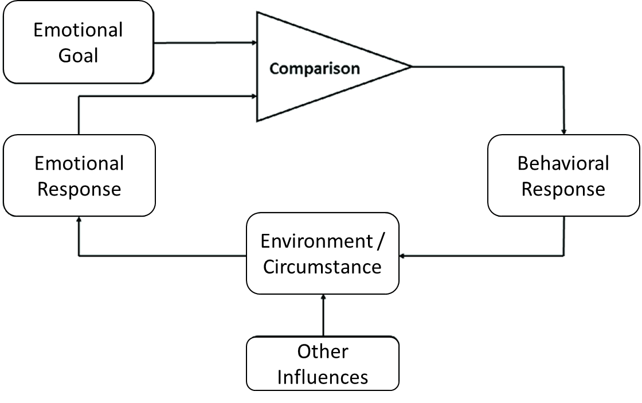
Emotion Influences Decision-Making
Understanding rationality demands understanding emotion ¹
Emotions are a dominant driver in everyday decisions ²
vmPFC impairments are associated with riskier financial decisions ³
More positive affect is associated with greater risk taking ⁴
Affect influences how we evaluate others and their ideas ⁵
*
*(and is influenced by)
Notes:
and there have been a number of models that have appreciated this cyclical association. Including the elegant 1980 Carver and Schier model, wherein the reality of one’s emotional experience is compared to one’s ideal emotional goals, which informs how they behaviorally respond to those circumstances, which then in turn changes their circumstances, which affects their emotional state and the cycle perpetuates. But if we want to explore how developmental changes influence affective representations

Slide 15
Emotion Influences Decision-Making
Understanding rationality demands understanding emotion ¹
Emotions are a dominant driver in everyday decisions ²
vmPFC impairments are associated with riskier financial decisions ³
More positive affect is associated with greater risk taking ⁴
Affect influences how we evaluate others and their ideas ⁵
Emotional Goal
Comparison
*
Emotional Response
Behavioral Response
Environment/Circumstance
*(and is influenced by)
Notes:
We’re going to want to focus on this pathway specifically
And we’re also going to want to expand upon this overly general model

Slide 16
Affective Decision-Making Pipeline
Environment/Circumstance
Emotional Response
Comparison
Behavioral Response
Notes:
Because there are stages that we’re sort of smoothing over in this example that might have important effects upon subsequent decision making behavior.

Slide 17
Affective Decision-Making Pipeline
Experience
Perception
Representation
Assessment
Decision
Behavior
Notes:
So I like to think of the relationship in these terms.
This is by no means a formalized model but more of an expansion upon the carver and scheir model which I’m hoping to work through in my research.

Slide 18


Affective Decision-Making Pipeline
Something happens
Experience
Perception
Representation
Assessment
Decision
Behavior
Notes:
We can start with something affectively relevant happening in one’s environment or circumstances. We could imagine Mirabelle trying to gracefully exit the park. This event is

Slide 19


Affective Decision-Making Pipeline
Something happens
Experience
We notice it happens
Perception
Representation
Assessment
Decision
Behavior
Notes:
Perceived by our unimodal sensory receptors, enters our brain and begins to make its way towards more transmodal network hubs,

Slide 20

Affective Decision-Making Pipeline
Something happens
Experience
We notice it happens
Perception
We process the event, identify relevant info
Representation
Assessment
Decision
Behavior
Notes:
At which point, the information begins to be integrated and representations of what we’ve experienced begin to form. We can think of this part of the process as making connections, building an understanding, putting the puzzle together, and trying to get a veridical picture of the event.
We can start to conceptually understand from the inputs we’ve received that Mirabelle is leaving the park

Slide 21

Affective Decision-Making Pipeline
Something happens
Experience
We notice it happens
Perception
We process the event, identify relevant info
Representation
We evaluate our circumstance
Assessment
Decision
Behavior
Notes:
This veridical picture allows us to assess its relevance to our circumstances and our broader goals. Ya know, I don’t want Mirabelle to leave, she’s my favorite character. I don’t like this. If we assess an incongruence between our goals and circumstances

Slide 22

Affective Decision-Making Pipeline
Something happens
Experience
We notice it happens
Perception
We process the event, identify relevant info
Representation
We evaluate our circumstance
Assessment
We plan what to do
Decision
Behavior
Notes:
We may then engage cognitive processes to figure out what we’re going to do to change the situation to meet our goals. We can decide what we’re going to do to keep Mirabelle here.

Slide 23

Affective Decision-Making Pipeline
Something happens
Experience
We notice it happens
Perception
We process the event, identify relevant info
Representation
We evaluate our circumstance
Assessment
We plan what to do
Decision
We take observable action
Behavior
Notes:
And lastly, we take action to achieve our goals, which might involve a little acting out. Of course we should be asking is it fair to conceptualize acting out as a child as a decision in a classic sense and I think developmental neuro is right there with you.

Slide 24
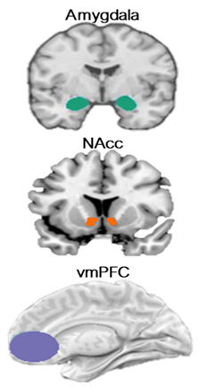


Affective Neural Development
In adults, AMY and NAcc project to vmPFC and vmPFC projects back to subcortical regions, constituting part of an affective self-regulatory loop. ¹⁻³ During development, projections from amygdala to vmPFC may emerge earlier than projections from vmPFC to amygdala ^{4,5}
Quality of vmPFC-AMY connectivity alters around age 10 ⁶
1 Davis and Whalen, 2001
2 Levita et al., 2009
3 Bjanji et al., 2019
4 Bouwmeester et al., 2002a
5 Bouwmeester et al., 2002b
6 Gee et al., 2013
Notes:
Because what we see in the affect and emotion regulation literature are early deficits in the connectivity between regions we classically associate with cognitive control like the ventromedial prefrontal cortex and regions we often associate with valence assigners or visceral affective trackers like the amygdala and nucleus accumbens. Specifically, in adults we see robust projections from these subcortical structures to the vmPFC and then from the vmPFC back to these subcortical structures. Constituting part of an affective self-regulatory loop we often see activated during reappraisal tasks and similar self-regulation research.
However, it’s important to note that again, these structures undergo significant change during development. Animal research suggests that significant projections from the amygdala to the vmPFC may emerge much earlier than projections from the vmPFC to the amygdala
And that the quality of these connections once they do emerge only begin to resemble adult like qualities starting at age 10, with progress coming as the child develops.

Slide 25
Affective Decision-Making Pipeline
Something happens
Experience
We notice it happens
Perception
We process the event, identify relevant info
Representation
We evaluate our circumstance
Assessment
We plan what to do
Decision
We take observable action
Behavior
Notes:
So it seems pretty clear that we should expect to see differences in the self-regulatory or decision-making sphere, but the extent to which differences might exist even at preceding stages is still a little unclear.

Slide 26

Development & Affective Behavior
Children as young as 2 years use language to express emotions ¹
Children are better at recognizing others’ emotions with age ²
Emotional development is influenced by:
Family ³
Peers ²
Language ⁴⁻⁷
Development adds to nuance to representations of affective information via Differentiation Models ^{5,8}
Valence still holds significance, but is not as defining to emotion differentiation in adulthood ⁹⁻¹¹
1 Wellman et al., 1995
2 Fabes et al., 1991
3 Dunn et al., 1991
4 de Rosnay and Harris, 2002
5 Pons et al., 2003
6 Nook et al., 2017
7 Hoemann et al., 2019
8 Widen & Russel, 2003
9 Ansfield, 2007
10 Krumhuber and Manstead, 2009
11 Szczurek et al., 2012
Notes:
The behavioral developmental literature may speak a little to this We do know that affective expression starts early
and that the complexity of semantic expression
as well as the ability to recognize emotions in others increases with age through early development
(PAUSE)
These gains seem to be moderated by the richness of one’s social environment.
Kids that grow up within families and among peers that give greater prominence to affective expression
And exposure to more complex language tend to have more advanced emotion expression and labeling skills.
(PAUSE)
One of the proposed mechanisms is that these different mediums function to improve representations of affective information
and this notion largely comes from differentiation models of emotional development
which suggest that kids start out with relatively simplistic understandings of emotion
that fall pretty tightly along valence lines like Good and Bad or Positive and Negative
and grow progressively more nuanced and complex with age. It should also be noted that the vmPFC has been implicated in these sorts of emotion differentiation in adults.

Slide 27
Affective Decision-Making Pipeline
Something happens
Experience
We notice it happens
Perception
We process the event, identify relevant info
Representation
We evaluate our circumstance
Assessment
We plan what to do
Decision
We take observable action
Behavior
Notes:
And so it stands to reason that even beyond the obvious decision-making, self-regulatory differences between kids and adults, that we might see differences in how we represent affective information as well

Slide 28
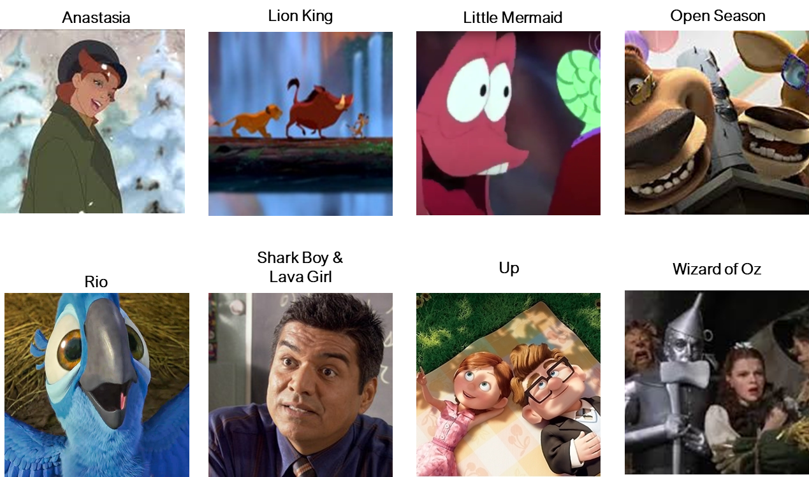





THE BIG QUESTION
How similarly do children and adults represent the same affective information?
Notes:
And so the real question we wanted to explore was how similarly children and adults represent the same affective information. If we had both groups, say, watch a film clip

Slide 29
Experience
Perception
Representation
Assessment
Decision
Behavior
THE BIG QUESTION
How similarly do children and adults represent the same affective information?
Notes:
Wherein the environment, the affective materials, and other aspects of the experience were held constant

Slide 30
Experience
Perception
Representation
Assessment
Decision
Behavior
THE BIG QUESTION
How similarly do children and adults represent the same affective information?
Notes:
Would we see similar patterns of neural activation between adults and children. Of course, there are a lot of ways someone could try to answer this question.

Slide 31





Emotion is:
Dynamic
Multimodal
Multidimensional
Notes:
In a more traditional study, we might identify a static, IAPS style stimuli set of affective images, ask participants to view them and then examine unimodal activation in specific regions. However this approach wouldn’t quite capture the nuance of affective representations. That’s because affect can unfold and change over a timecourse through a very dynamic process, affect is also attentive to multimodal experiences. You know, we’ve all seen a movie whose emotional impact was heighted by a very moving score underlying it. Affective processes are also multidimensional and can be characterized by valence, intensity, dominance and a number of other characteristics. Unfortunately, picture sets alone really don’t do a great job of capturing or representing some of these things

Slide 32
Traditional unimodal stimuli sets may not elicit sufficient affective responses
Naturalistic movie stimuli can move us towards greater ecological validity, yielding more accurate affective representations
Emotion is:
Dynamic
Multimodal
Multidimensional
Notes:
For this reason, traditional unimodal stimuli can often run into this problem where researchers fail to elicit sufficient affective responses. With recent advances in technical and computational resources, and plenty of pivotal studies that laid ground work for this appraoch, movie stimuli are not only feasible to use, but also might yield more accurate affective representations.

Slide 33
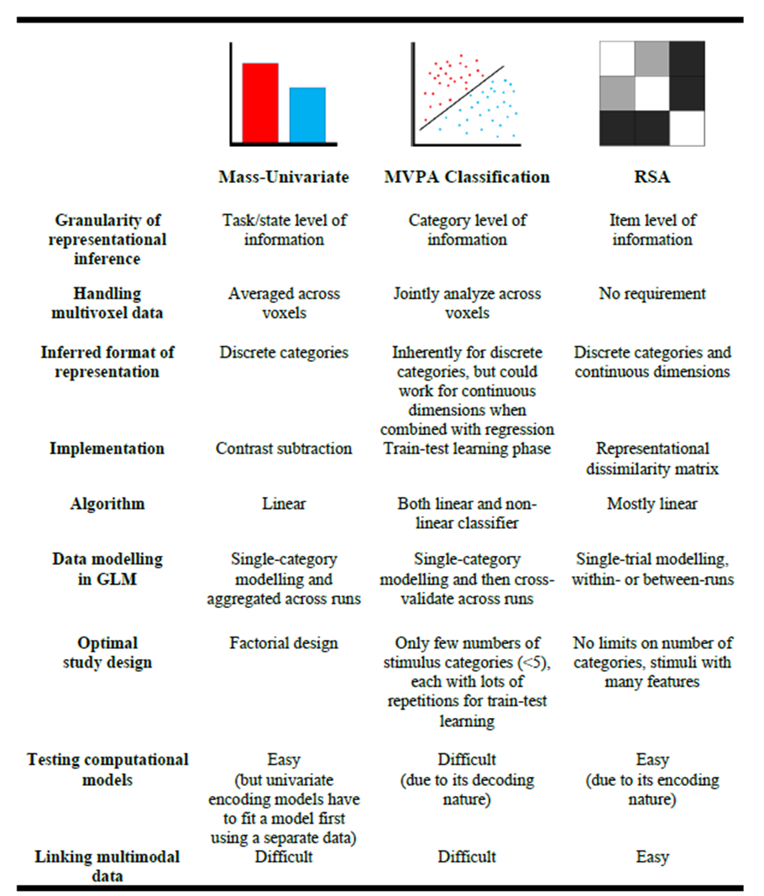
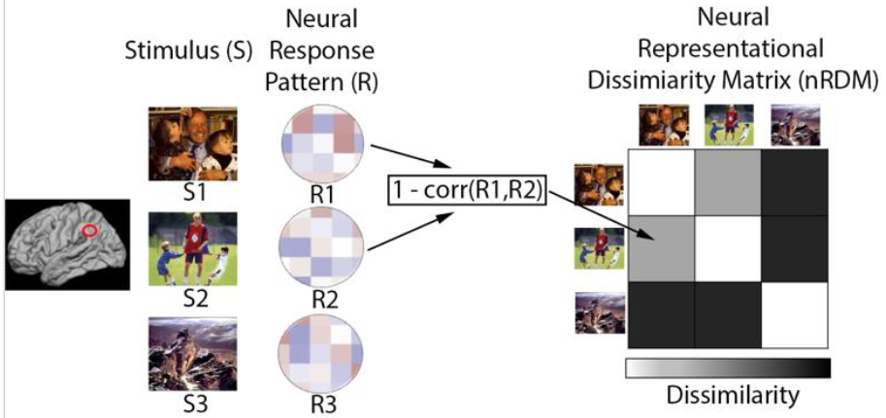
Introducing RSA
Representational Similarity Analysis (RSA) is a statistical methodology that allows us to analyze relative similarity among a set of stimuli based upon the pattern that response to the stimuli produces.
Popal, Wang, Olson, 2020
Notes:
However, a dimension rich stimuli necessarily must be paired with an analytic approach that can capture the nuance in the pattern of neural changes that accompany it, which univariate approaches often fail to do. When we simply average activation across voxels, treating each voxel as essentially interchangeable across time and space, we can fail to pickup on changes that are spatially or temporally specific.
The family of multivoxel pattern analysis approaches on the other hand are very good at picking up at these nuances in neural patterns. Representational similarity analysis specifically, highlights the influence of any number of stimuli features upon the resultant neural patterns one could observe across trials at the item level. So, theoretically, if we I wanted to understand the degree to which items such as positive and negative valence seem to be represented in neural activation patterns, I could ask participants to watch a number of different positive and negative film clips, which act as trials, with variance around these common items and then I could examine how similar or dissimilar the resulting patterns were from one another. Unfortunately, I don’t have a ton of time to get into RSA today, but I highly recommend Haroon Popal’s 2020 paper implementing RSA in social neuroscience, which is where I appreciatively stole these lovely figures from.

Slide 34
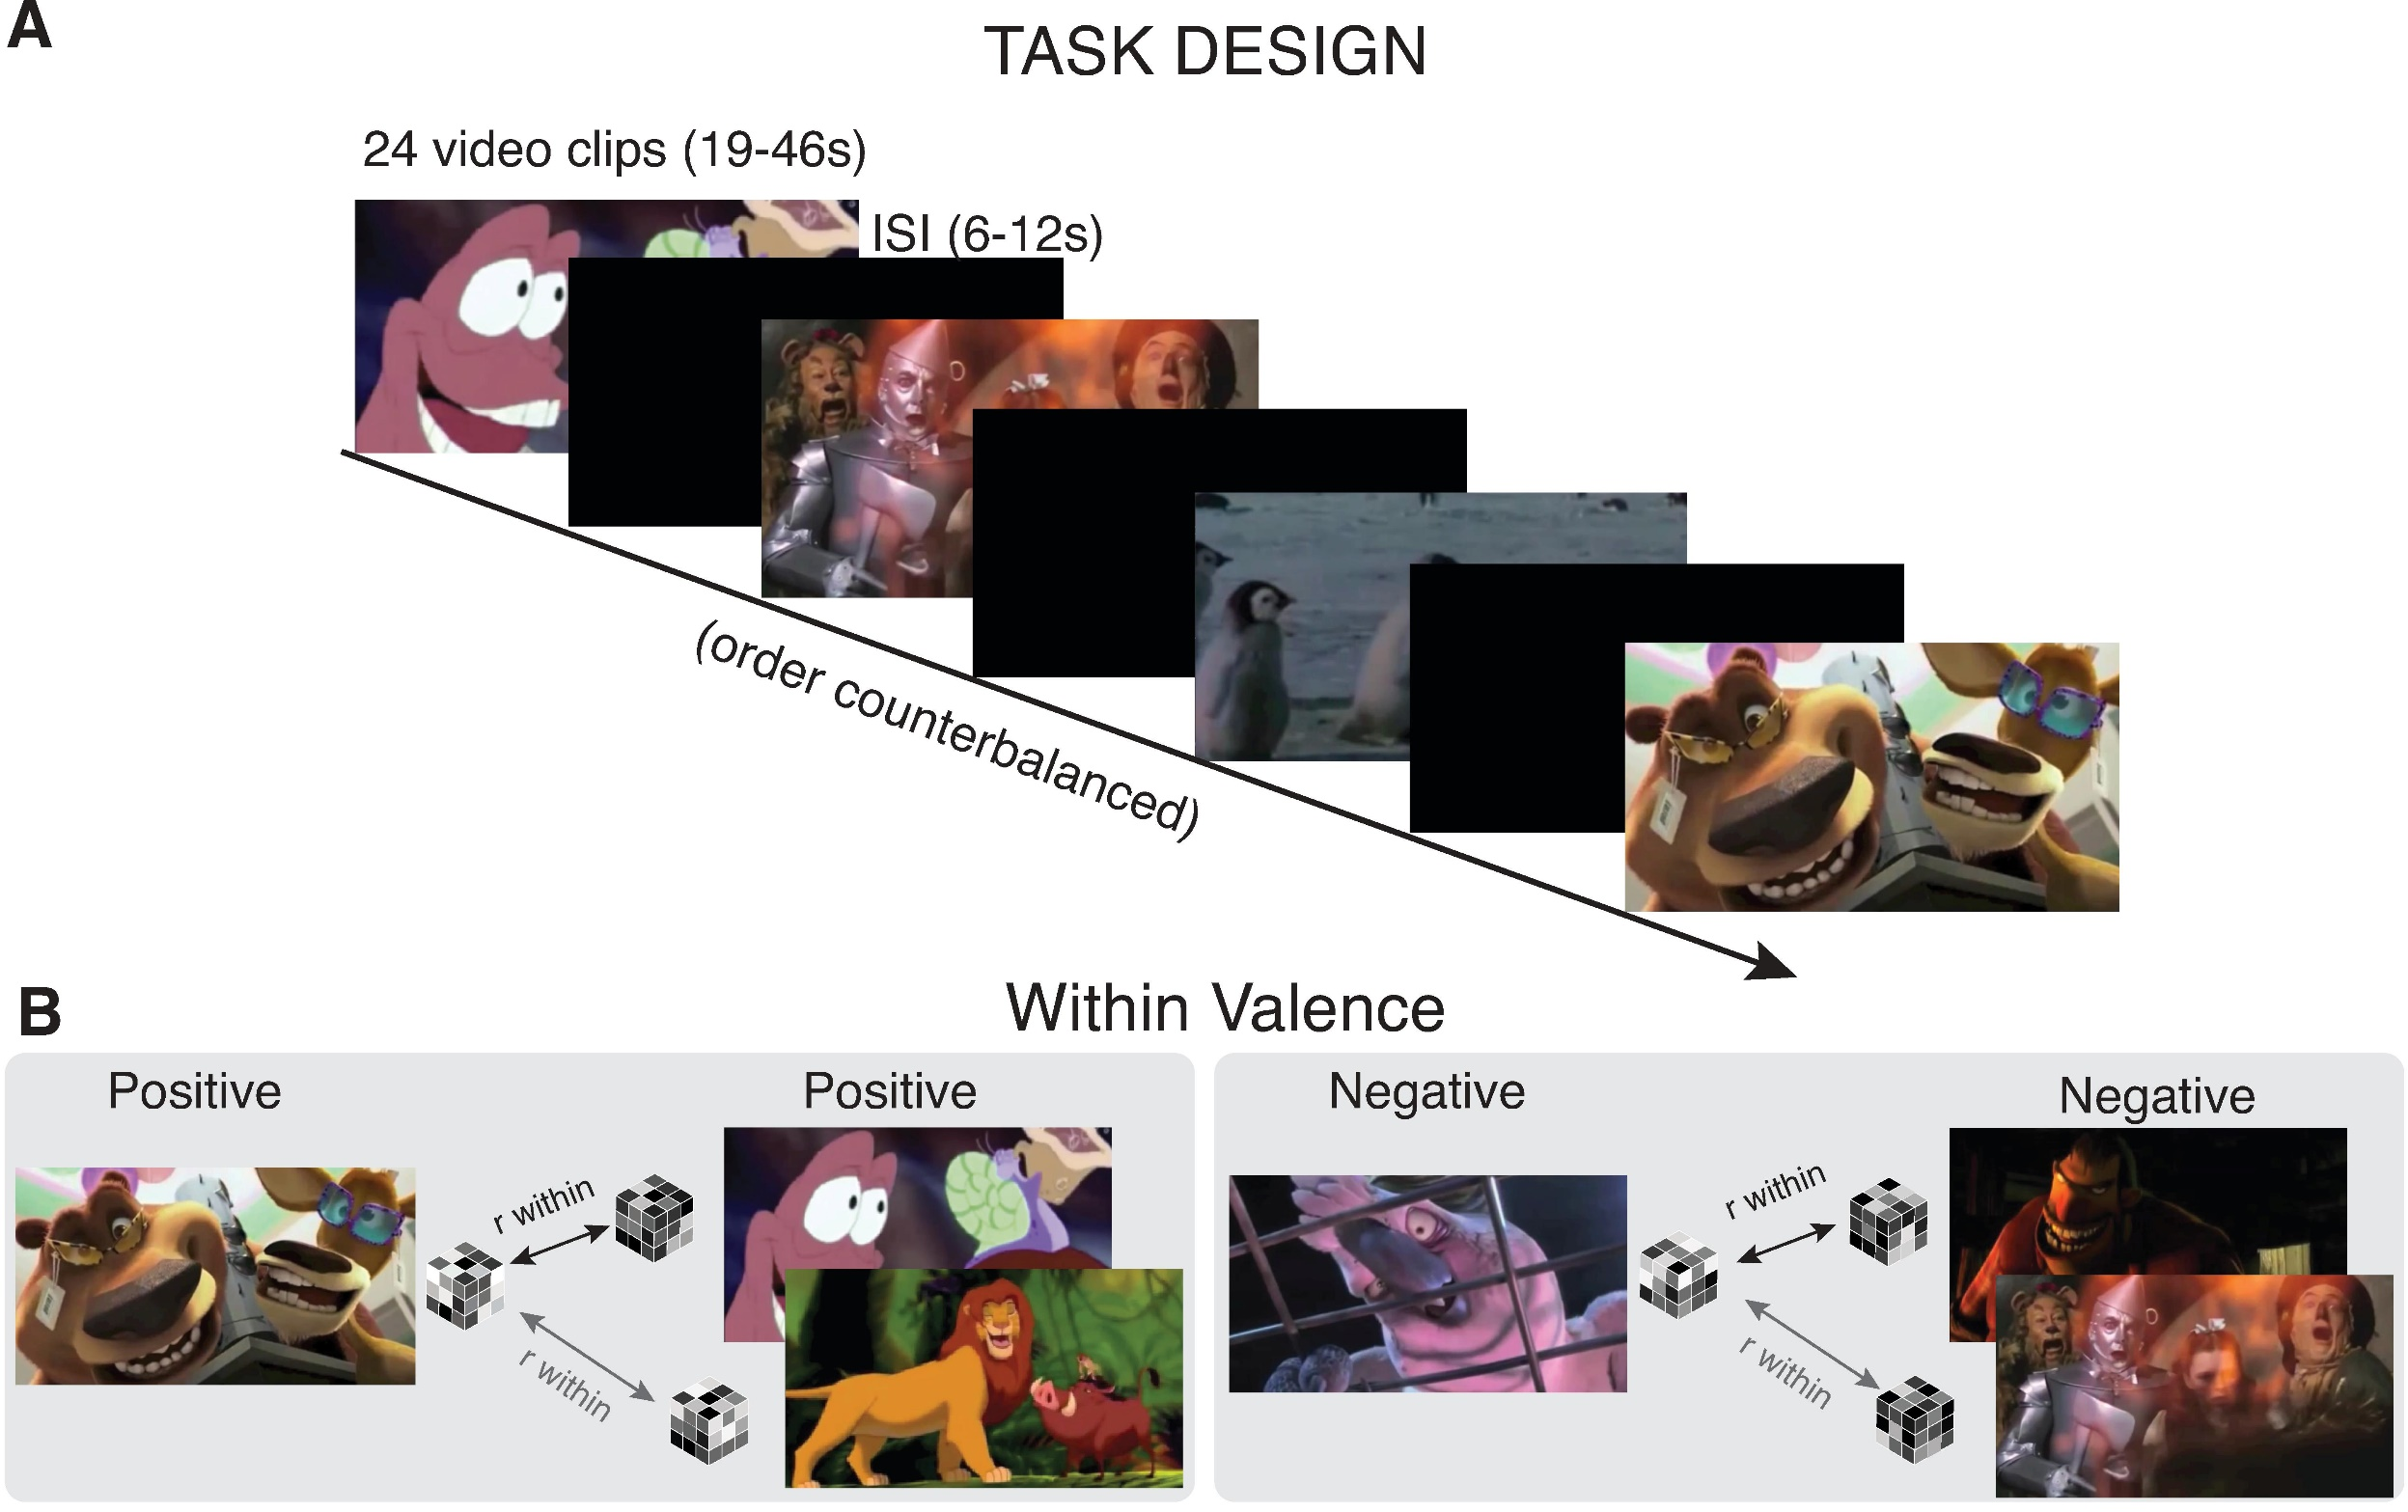
Why RSA?
Notes:
What we need to know right now though is that an RSA approach allows to us see with greater clarity
how similar representations of otherwise intangible properties are across different groups of people.
(PAUSE)
So if we could show different videos containing positive, negative, and neutral affective information
to adults and children
while they sit in an MRI machine
(PAUSE)
we could apply an RSA approach to their data and explore how similarly they were representing that information
and that's exactly what we did in our recent study.

Slide 35

Our Data
57 participants
36 children, 21 adults
12 excluded for excessive head motion
Final sample:
25 Children
ages 4-10 (M =7.4 yrs, sd = 1.85 yrs)
20 Adults
ages 20 - 44 (M =26.7 yrs, sd = 5.20 yrs)
Notes:
We used a pre-existing dataset originally collected by Susan Perlman and her team,
That includes 57 participants that were either children between the ages of 4 and 10,
or adults between the ages of 20 and 44
who passively viewed video stimuli within the context of fMRI

Slide 36
Stimuli
Twenty-four clips from popular children’s movies
8 pos., 8 neg., 8 neut.
Each film provided 1 pos. and 1 neg. clip
Neut. clips sourced from nature documentaries
No difference between adult and child familiarity scores
Clips were randomized into three orders and assigned to participants at random
Notes:
It consisted of 24 clips from popular movies
that were evenly divided into positive, negative, and neutral valence categories.
(PAUSE)
Clips contained both animated and live action movies,
anthropomorphic and human characters
and spanned a long time period, with release dates from 1939 to 2011.
In total, participants were exposed to about 20 minutes of continuous stimuli
(PAUSE)
So, again, we have a high volume of stimuli with a lot of variability surrounding a few core common traits.

Slide 37
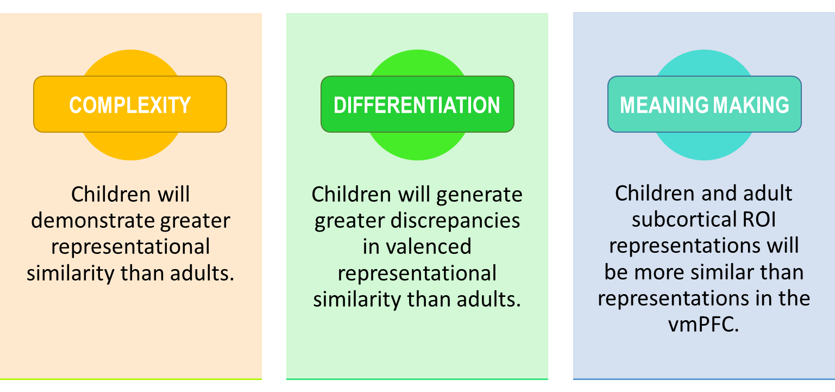
Hypotheses
Notes:
And we wanted to test a few hypotheses with this setup First is what I would consider general complexity. Because from the behavioral research, we know that expressions of affect grow more nuanced as children age, we should expect to see that neural representations among children are generally more similar to one another than are adults

Slide 38
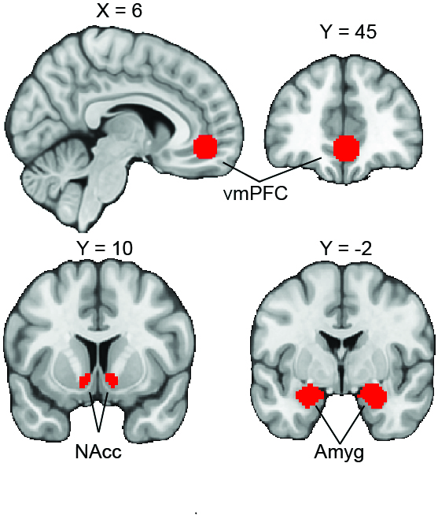
Regions of Interest
Amygdala
Nucleus Accumbens
Ventromedial Prefrontal Cortex
Masks Used
Notes:
We focused on three regions relevant to our question:
the Amygdala, the nucleus accumbens
and the ventromedial prefrontal cortex.
(PAUSE)
We defined our amygdala and nucleus accumbens ROIs using the masks contained within the Harvard-Oxford subcortical atlas,
but used a 10mm diameter activation-centered isotropic kernel to define the vmPFC.
(PAUSE)
The mask centered on coordinates identified in a metaanalyses by the Kable lab
as the most common center of consistent vmPFC activation during studies of subjective valuation.

Slide 39

Supported
Overall, children did demonstrate greater pattern similarity relative to adults
Notes:
And what we found for the main effect of age in our mixed effects models was that children did generate greater pattern similarity in response to these affectively valenced stimuli relative to adults, Or in other words, the neural patterns that adults generated were similar to one another than the patterns that children had generated. What we think this suggests is that affective developmental differences can be observed in complex neural patterns. But we can get much more specific

Slide 40
Hypotheses
Notes:
Building upon our first hypothesis we wanted to explore intra-valence differentiation across ages Researchers have theorized that children generate representations of affect that fall pretty strongly along valence lines,
while the complexity of affective representations in adulthood
Might render valence to be an insufficient framework to apply to adult representations.

Slide 41

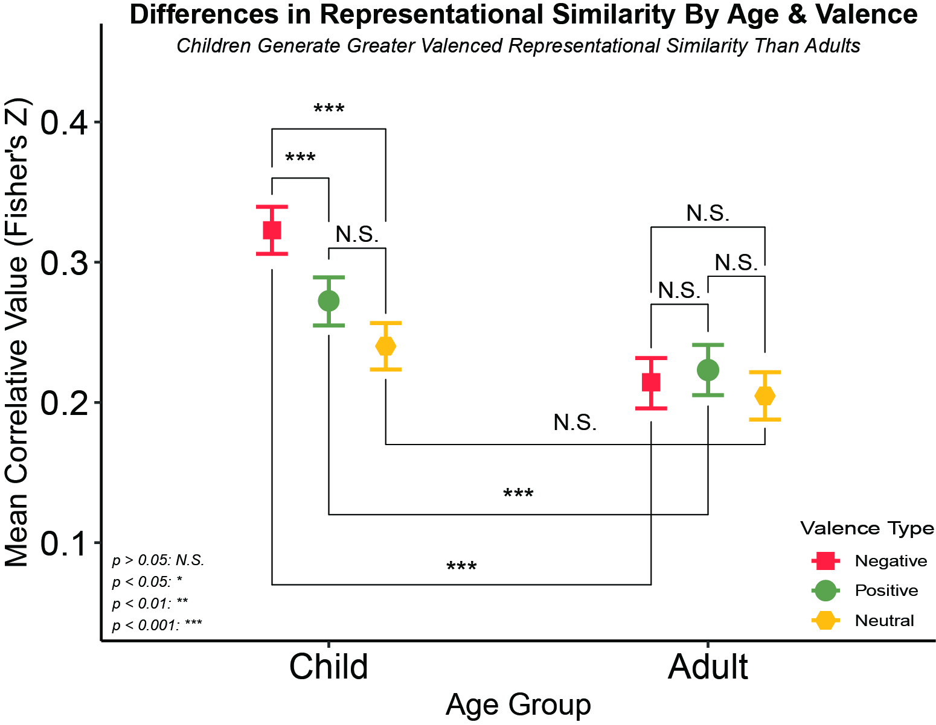
Supported
Children Generate Greater Valenced Representational Similarity Than Adults
Children also demonstrated greater affective pattern similarity relative to our neutral control, while adults did not seem to differentiate along affective lines.
Notes:
Going back to the interaction between valence and age in our mixed effects models, we actually found support for this notion. On the X axis, we have our age groups,
on the y axis we have our correlative values, and orange, green, and yellow for negative, positive and neutral valences respectively
so higher values mean that the patterns we observed were more similar to each other,
and lower values mean that they were less similar to each other within that specific Age / Valence group.
And lastly, we have valence as our moderator with relevant key over to the right.

Slide 42
Supported
Children Generate Greater Valenced Representational Similarity Than Adults
Children also demonstrated greater affective pattern similarity relative to our neutral control, while adults did not seem to differentiate along affective lines.
Notes:
First, we see no differences among adults by valence
This is in line with what we suspect, that valence might not be as appropriate of a heuristic or model for adults, being too general

Slide 43
Supported
Children Generate Greater Valenced Representational Similarity Than Adults
Children also demonstrated greater affective pattern similarity relative to our neutral control, while adults did not seem to differentiate along affective lines.
Notes:
For children, we do see differences between negative and positive and positive and neutral,
But interestingly enough not positive and neutral
This difference could be a product of the prominence a lot of negatively valenced events demonstrate
Especially in moral domains for children.

Slide 44
Supported
Children Generate Greater Valenced Representational Similarity Than Adults
Children also demonstrated greater affective pattern similarity relative to our neutral control, while adults did not seem to differentiate along affective lines.
Notes:
But, most important,
We see that both positive and negative, but not netural valenced stimuli,
Generated greater pattern similarity in children relative to adults,
Again which suggests that children are representing negative things pretty similarity to other negative things
And positive things pretty similarity to other positive things,
And not differentiating as much nuance as their adult counterparts seem to be doing

Slide 45
Hypotheses
Notes:
Lastly, because of the profound functional and connective prefrontal developments,
relative to subcortical developments,
we expected to see an interaction
Such that the difference in pattern similarity between child prefrontal and subcortical regions
should be greater than the difference between adult prefrontal and subcortical regions.
(PAUSE)
And of course, we take this to be a sign that adults are demonstrating greater ability in that post-representation assessment stage.

Slide 46

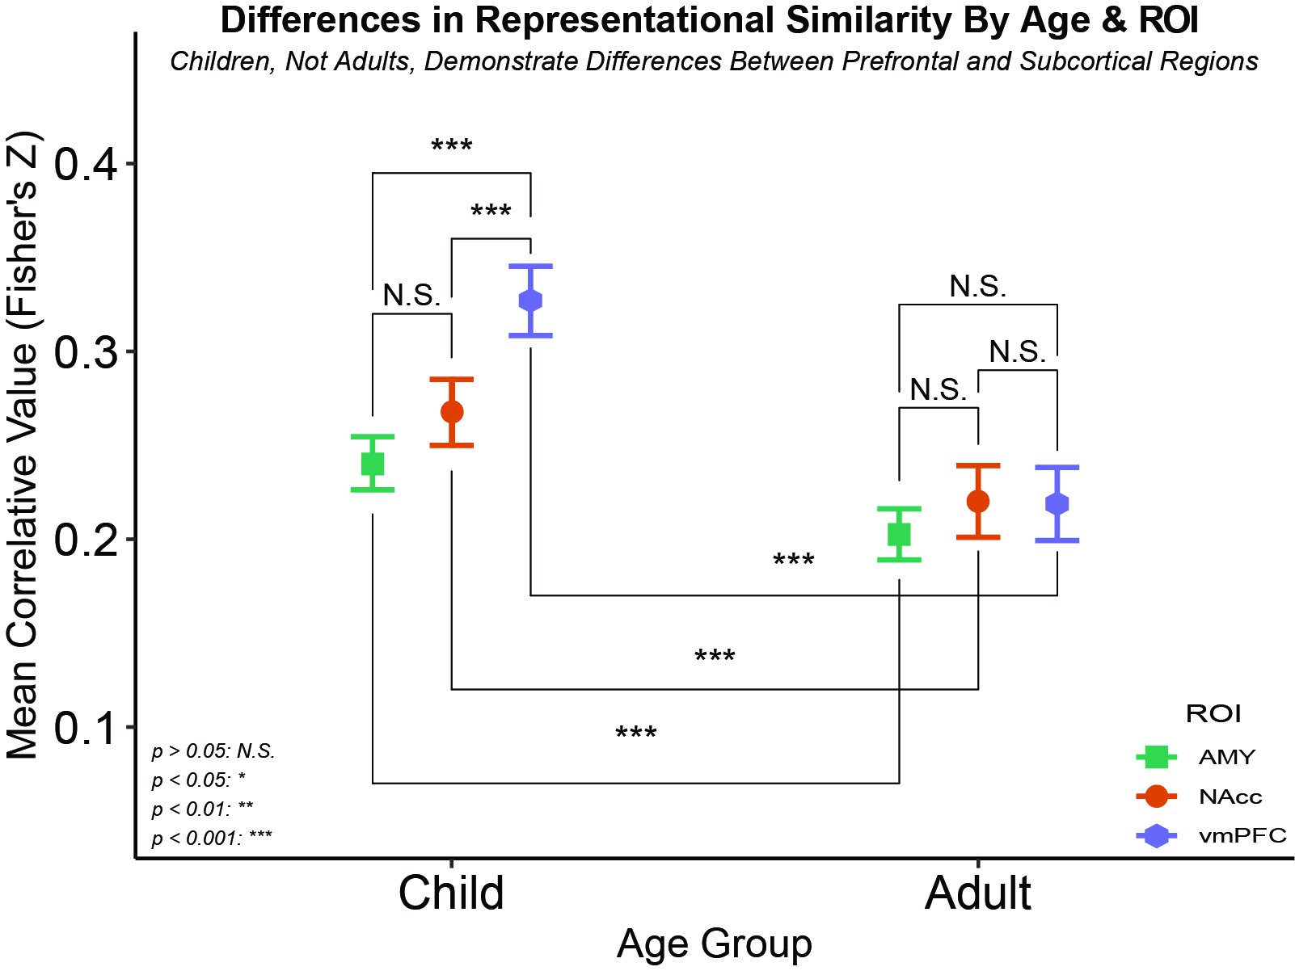
Supported
Adults demonstrated no ROI differences while children demonstrated differences between the vmPFC and each subcortical structure
Notes:
We again have our age groups on the X axis
on the y axis we have our correlative values,
And our ROIs are represented in the legend, with the amygdala being sort of turquoise, the nucleus accumbens being orange, and the vmPFC being purple.
And lastly, we now have ROI as our moderator with a little reminder of where each region is located on the left.

Slide 47
Supported
Adults demonstrated no ROI differences while children demonstrated differences between the vmPFC and each subcortical structure
Notes:
We again see little pattern similarity among adults by region

Slide 48
Supported
Adults demonstrated no ROI differences while children demonstrated differences between the vmPFC and each subcortical structure
Notes:
However, children show far greater pattern similarity in the vmPFC than they do subcortical regions

Slide 49
Supported
Adults demonstrated no ROI differences while children demonstrated differences between the vmPFC and each subcortical structure
Notes:
Despite all regions showing a movement towards greater dissimilarity overall in the older cohort, the difference between the vmPFC and subcortical regions is more pronounced in children relative to adults.

Slide 50
Summary
Children did demonstrate pattern similarity across stimuli than adults
1
Children did demonstrate more similar patterns in response to negative stimuli than positive stimuli; adults did not
2
Children vmPFCs demonstrated greater pattern similarity than subcortical regions; adults did not
3
COMPLEXITY
DIFFERENTIATION
MEANING MAKING
Notes:
[Read the slide]

Slide 51

Implications
Affective representations may decrease in pattern similarity over normative development
Notes:
Taken together, a potential interpretation of our findings is that, in light of the region’s role in processing of emotional stimuli, the pattern and response similarities we find in children may signal their shared, relativelylimited experience of the vast array of potential affectively relevant experiences, while adults respond more divergently to novel affectively valenced information by referencing a wider berth of past evaluations.
this postulation fits nicely with rational constructivist-related theories of emotional development, in which humans start with proto-conceptual primitives to emotion that mature over time due to language and symbol learning,
Bayesian inductive learning and constructive thinking mechanisms

Slide 52
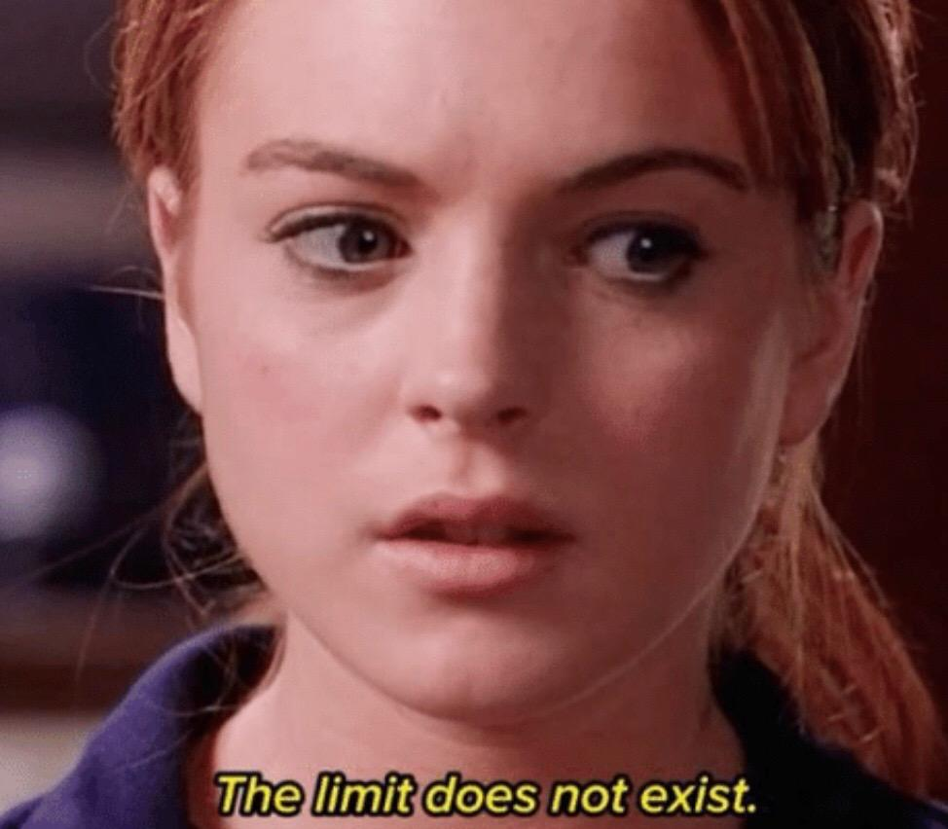

Limitations of Our Approach
Relatively small sample size
Lack of adolescent representation
Cannot connect representations to behavior/ decision-making
Cannot comment on contents of representations
Notes:
But of course, this study should really only be thought of as a very limited first pass in this space. First we have a fairly small sample for the span of development we are trying to capture. It’s also notable we have a massive gap in our sample, in that we have no adolescents
which might really complicate these relatively simplistic theories We also cannot make the claim that these representations are definitively affecting downstream processes Because we only examined passive viewing, we did not ask them to make decisions and we cannot be 100% sure about the contents of these representations But we have some work in the pipeline that I’m very excited and that will address these limitations

Slide 53


Notes:
In one ongoing study we are using movies and tv shows widely available to a general audience
to gauge affective decisions and responses continuously throughout exposure
and using novel analyses like hyperalignment to observe this process across participants.

Slide 54
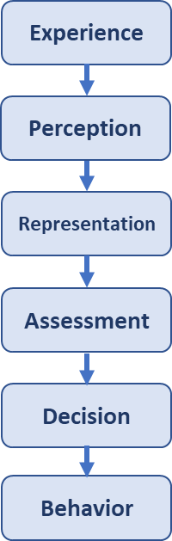
Notes:
This sort of is assessing differences at what I’m characterizing as the assessment or meaning making stage.

Slide 55

Notes:
But We also have an ongoing project in collaboration with the Murty Adaptive memory lab
in which we take participants to these quasi-naturalistic settings to measure emotional responses
in populations that have no regulation training
or really any idea that they are in a regulation study.
So in that we can assess contextual fit for self-reported cognitive process, behavioral processes,
and a whole other dimensions that I didn’t include here, that being physiological processes as well

Slide 56
Conclusion
Differences in affective representations exist between adults and children.
Differences may indicate a move away from visceral responses to more evaluative processes
Emotions are important tools to motivate behavior and decision-making
Notes:
READ SLIDE

Slide 57

Conclusion
Differences in affective representations exist between adults and children.
Differences may indicate a move away from visceral responses to more evaluative processes
Emotions are important tools to motivate behavior and decision-making
Notes:
And because emotions can be these really powerful tools,
we ideally want a reasonable degree of control over them.

Slide 58

Special Thanks to:
Chelsea Helion
Susan B. Perlman
Lindsey Tepfer
Susan Benear
Ginny Ulichney
Joanne Stasiak
Tiara Bounyarith Angelique Vittone
Deepu Murty
Nicole Henninger
Elizabeth Horwarth
Haroon Popal
Joy Ham
Helen Schmidt
Ian O’Shea
Sophia Tran

Slide 59
Citations
Simon, H. (1990). Reason in human affairs. Stanford University Press.
Lerner, J. S., Li, Y., Valdesolo, P., & Kassam, K. S. (2015). Emotion and decision making. Annual review of psychology, 66, 799-823.
Bechara, A., Damasio, H., Damasio, A. R., & Lee, G. P. (1999). Different contributions of the human amygdala and ventromedial prefrontal cortex to decision-making. Journal of neuroscience, 19(13), 5473-5481.
Nygren, T. E., Isen, A. M., Taylor, P. J., & Dulin, J. (1996). The influence of positive affect on the decision rule in risk situations: Focus on outcome (and especially avoidance of loss) rather than probability. Organizational behavior and human decision processes, 66(1), 59-72.
Wiltermuth, S. S., & Tiedens, L. Z. (2011). Incidental anger and the desire to evaluate. Organizational Behavior and Human Decision Processes, 116(1), 55-65.

Slide 60


Slide 61

Here’s an example!
Notes:
I thought it might be a good idea to give you all a little idea of what the clips were like,
so here’s one from a movie called Open Season

